Slide 1

EVERYTHING ABOUT SWEDEN

Slide 2
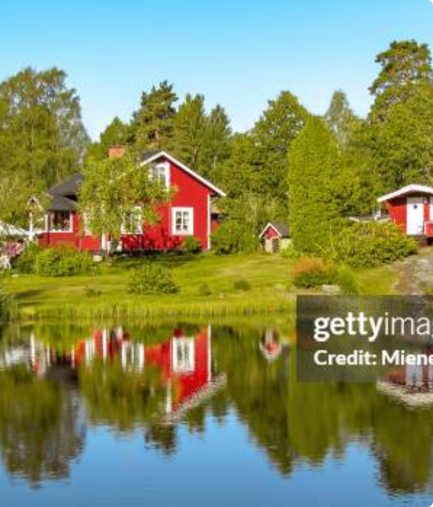
Nature & Landscape
The Scandinavian Peninsula
Sweden is the largest country in Scandinavia, captivating visitors with its pristine nature. More than 70% of its surface is covered by dense forests, providing a haven for rich wildlife.
The country boasts an impressive number of over 100,000 picturesque lakes, with Lake Vänern being the largest. The terrain consists mostly of lowlands and highlands, bordered by the majestic Scandinavian Mountains in the west.

Slide 3









Constitional Monarchy
The King
The Riksdag
Prime Minister
King Carl XVI Gustaf has been the Head of State since 1973. His role today is entirely representative and ceremonial, holding no executive political power over the country.
The unicameral Swedish parliament consists of 349 members, elected in general elections every four years. This is where national debates are held and all laws are passed.
The Head of Government is typically the leader of the largest party in the Riksdag. They direct the country's domestic policy, administration, and foreign affairs.

Slide 4

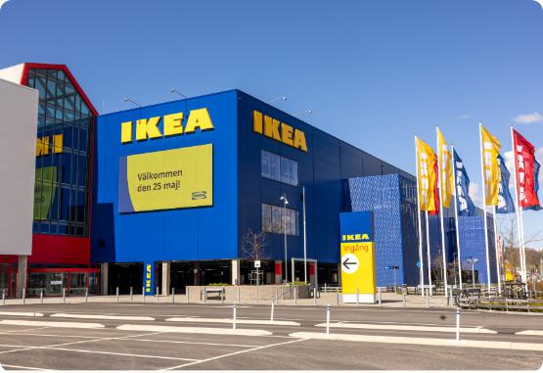
Global Swedish Design
■
Founded in 1943 by Ingvar Kamprad, IKEA stands as an undeniable symbol of modern Swedish design and innovation on the international stage.
■
The company is world-renowned for its flat-pack, self-assembly furniture, a concept that revolutionized global logistics and drastically reduced costs.
■
The characteristic blue and yellow colors of their store facades directly mirror the Swedish flag, acting as a proud ambassador for the country.
■
IKEA actively promotes Swedish culinary culture, offering traditional dishes—most notably their legendary meatballs—in their global restaurants.

Slide 5
Swedish Traditions
•fika” is a coffe break often with a cake.
•„Night Valborg” from april 30 to may 1, served to ward off evil spirits, today people light bonfires and get rid of old objects.
•„Night Valborg” from april 30 to may 1, served to ward off evil spirits, today people light bonfires and get rid of old objects.
•„Night Valborg” from april 30 to may 1, served to ward off evil spirits, today people light bonfires and get rid of old objects.

Slide 6


Popular Main Dishes
Raggmunk (Potato Pancakes)
Köttbullar (Meatballs)
Famous Swedish meatballs
Served with mashed potatoes
With gravy and lingonberry jam
One of the most popular Swedish dish
Swedish potato pancakes
Often served with bacon
Simple and filling dish

Slide 7




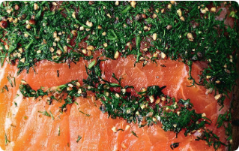

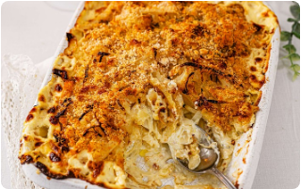

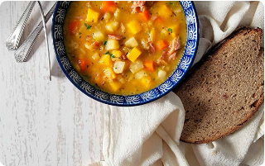
Fish and Traditional Soups
Gravlax
Jansson's Temptation
Ärtsoppa
Raw salmon cured with a mix of coarse salt, sugar, and fresh dill. It is served cold and remains an extremely popular and elegant appetizer.
A thick, classic yellow pea soup, often containing pork. Traditionally eaten on Thursdays, it is almost always followed by thin pancakes with jam.
A creamy, comforting potato casserole baked with distinct Swedish anchovies (sprats) and rich cream. It is a staple during major holiday feasts.

Slide 8
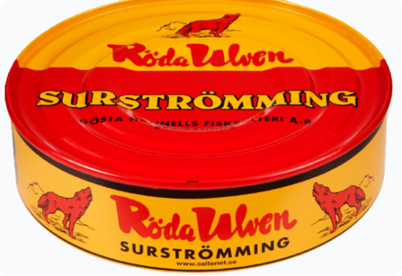
Surströmming: A Culinary Extreme
Fermented herring
Very strong smell
One of the most unusual dishes in the world.

Slide 9

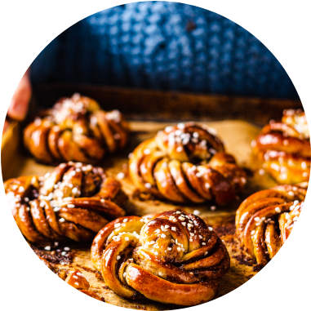
A Sweet Conclusion
The Iconic Kanelbulle
The sweet cinnamon bun which is called Kanelbulle, is anclassic in Sweden. It so universally loved that it has its own national day on October 4th. These buns are an essential part of "fika"—the beloved coffee break with friends or colleagues. Swedish cuisine and culture, though often rooted in simple traditions, never fail to capture the world's imagination and appetite. Enjoy your meal! (Smaklig måltid!)

Slide 10
Thank you!

