Slide 1


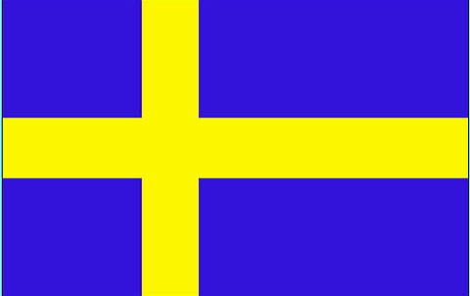
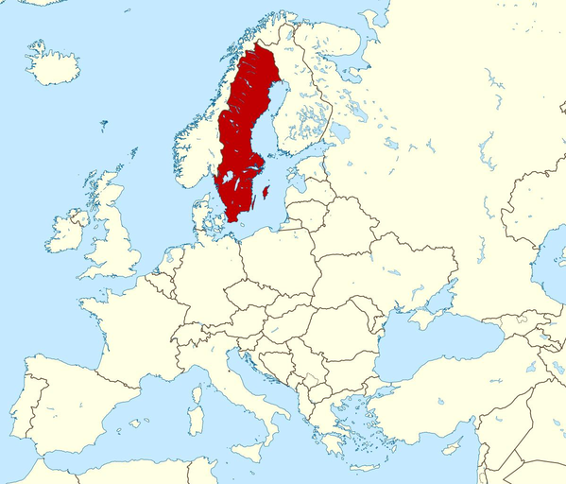
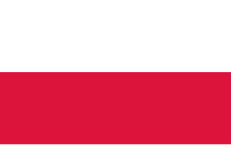
SWEDEN
By Class 6th

Slide 2
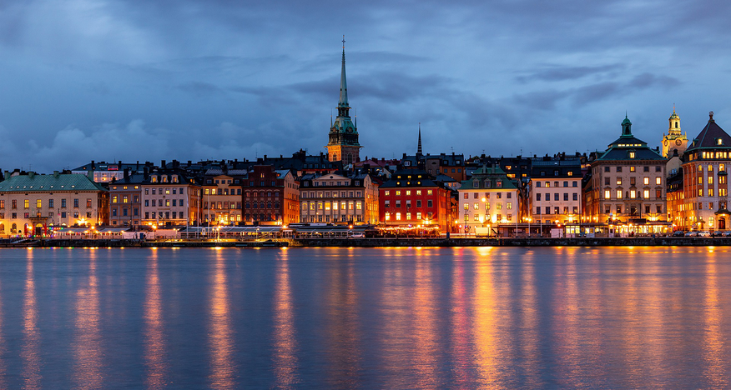
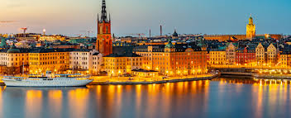
INFORMATION
COUNTRY: SWEDEN
CAPITAL: STOCKHOLM
POPULATION: ABOUT 10.5 MILLION
AREA: ABOUT 450,000 KM²
LANGUAGE: SWEDISH
CURRENCY: SWEDISH KRONA (SEK)
KING: CARL XVI GUSTAF

Slide 3
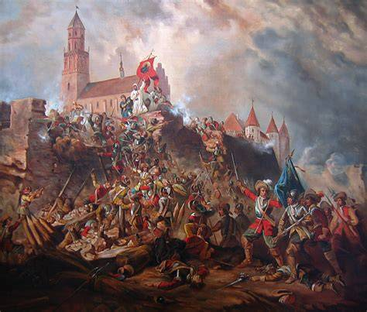
Most important moments in history of Sweden
5.Poland and Finland - in XVII century Sweden conquered part of Poland and Finland that ma
1.Viking Era - Vikings known for having big influence on Scandinavian region
2.Union with Denmark - Sweden and Denmark created union in 1397
3.Wars with Russia - Sweden had many wars with Russia for example with Poland and Denmark
  King Gustav Vasa - modernized and made sweden independent

Slide 4
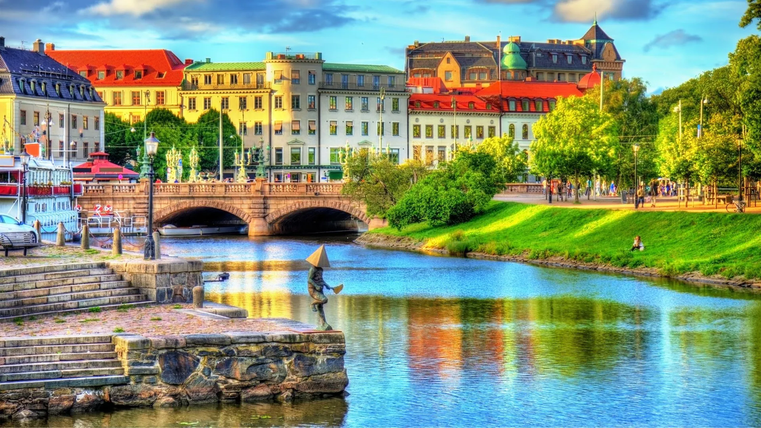
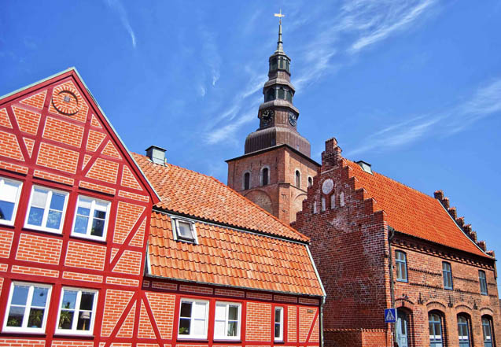
ARCHITECTURE
SWEDISH ARCHITECTURE BLENDS MINIMALIST ELEGANCE, ENVIRONMENTAL SUSTAINABILITY, AND BOLD INNOVATION, CREATING SOME OF THE WORLD’S MOST STRIKING BUILDINGS FROM MEDIEVAL CASTLES TO MODERN SKYSCRAPERS.

Slide 5
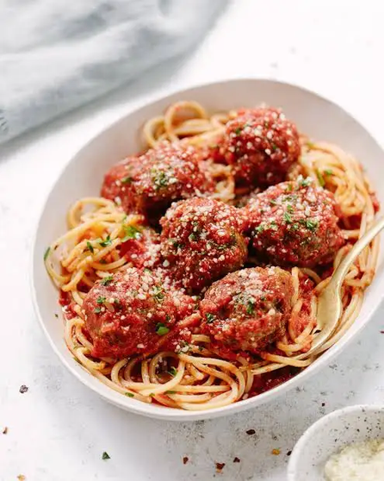
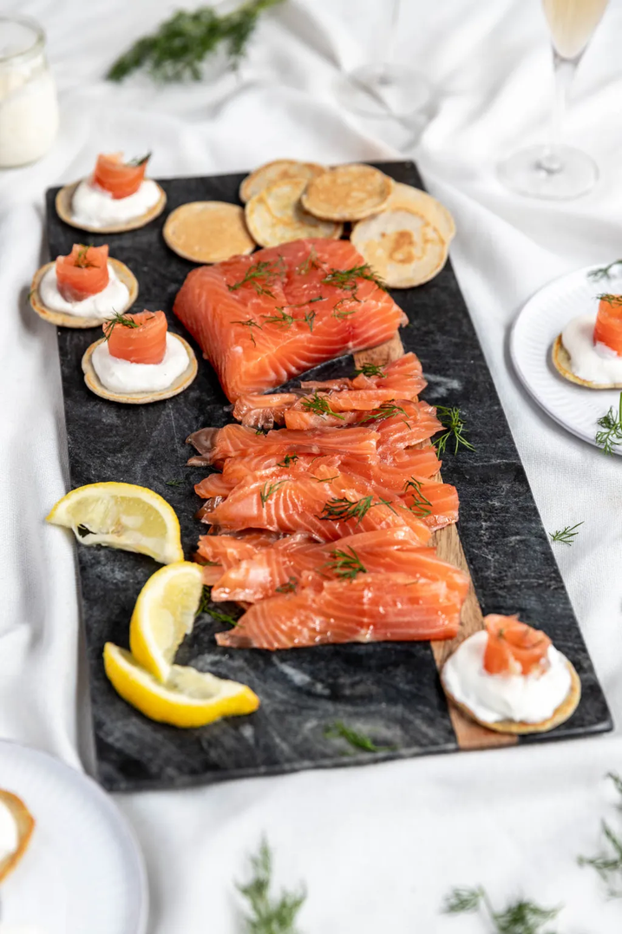
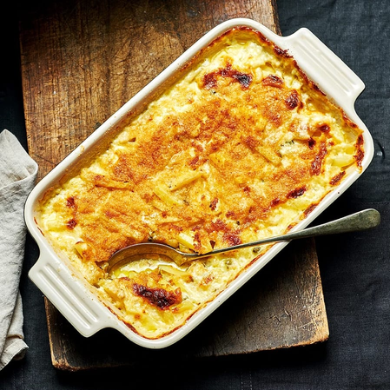
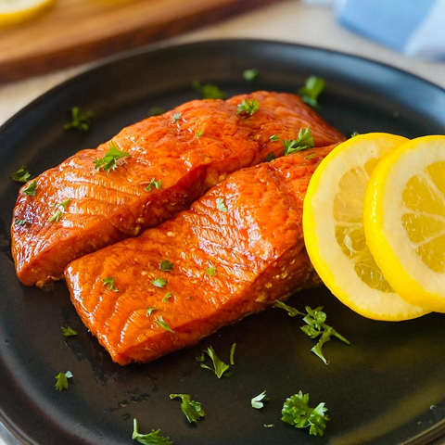
FOOD🍰
🐟 Seafood & Fish
  Pickled herring
  Smoked Salmon
🍲Classic Swedish Dishes
  Meatballs
  Gravlax (consisting of raw salmon)
  Janssons frestelse
🍰 Desserts & Sweets
  Prinsesstårta – sponge cake
  Kanelbullar - cinnamon buns

Slide 6
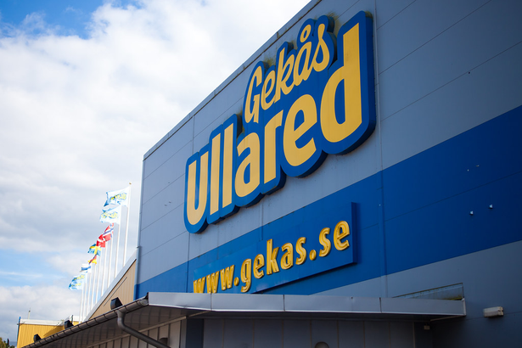
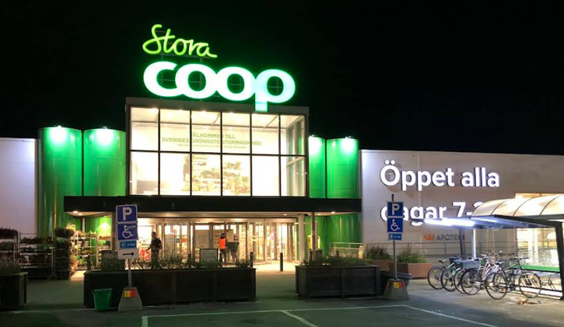
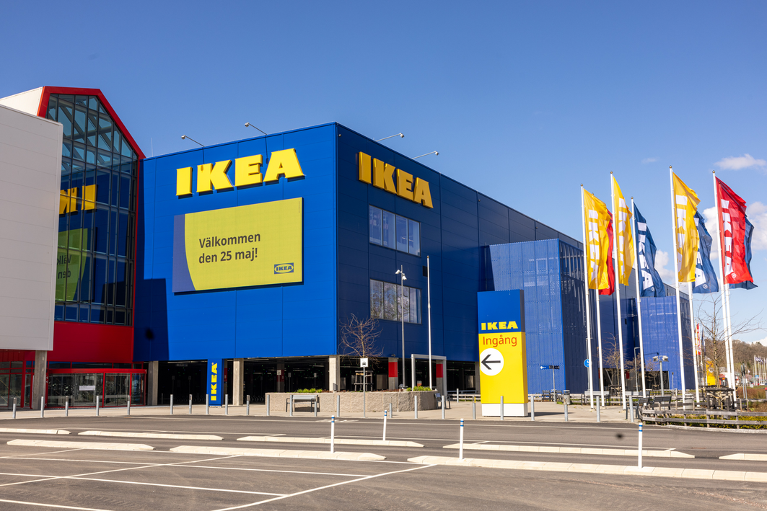
⇒WE AS POLES CONSIDER IKEA IS THE MOST FAMOUS SWEDISH STORE, HOWEVER...⇐
EVEN THOUGH IKEA IS ONLY IN FOURTH PLACE, “GEKÅS ULLARED” IS THE MOST POPULAR STORE
ICA COMES IN SECOND, THEN PROBABLY H&M.
THE CHEAPEST STORE IN SWEDISH IS..... LIDL!!! DO YOU KNOW THIS STORE? WE HAVE THIS SHOP IN OUR COUNTRY, IN POLAND
THE MOST EXPENSIVE IS FOR EXAMPLE COOP AND HEMKÖP

Slide 7
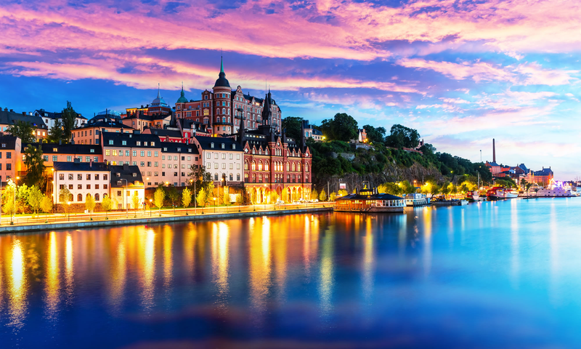
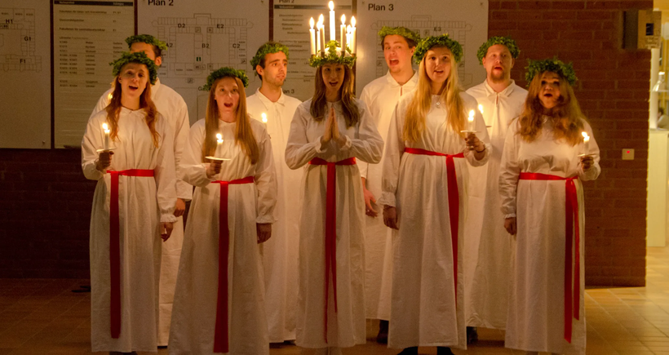
TRADITIONS
FESTIVALS AND HOLIDAYS
In Sweden, Saint Lucia's Day, celebrated on December 13, is one of the most important holidays. It symbolizes light and hope in the darkest period of the year, when the days are shortest and the nights longest. This unique holiday combines both pagan and Christian elements, creating a unique blend of traditions.
In every town, processions take place, led by a girl dressed as Lucia. Traditional songs, such as "Santa Lucia", which carry a message of light and hope, are sung during the parade.
Midsommar- festival of summer solstice when people dance around pole decorated with flowers.

Slide 8
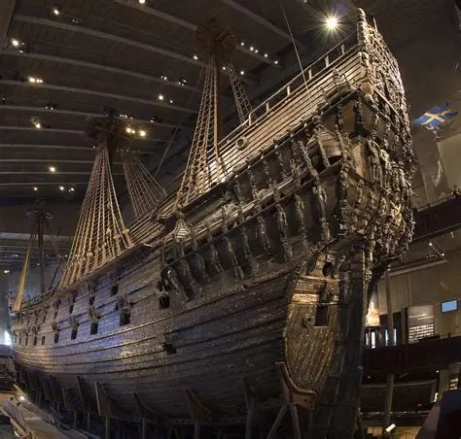
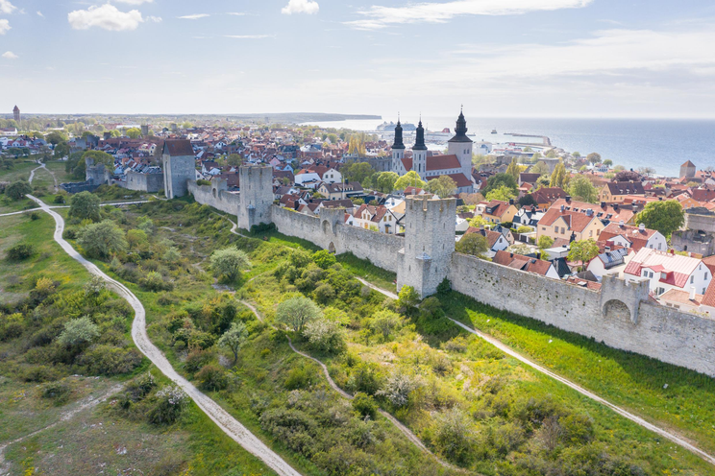
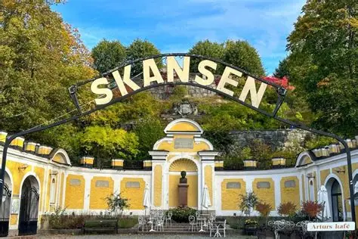
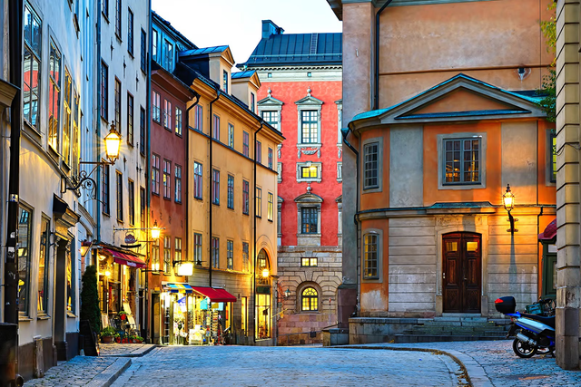
ATTRACTIONS
  Vasa Museum
  Gamla Stan
  Visby
  Skansen

Slide 9
LANGUAGE
dzień dobry-god morgon
dziękuję-tack
przepraszam-ledsen
proszę-behaga
do widzenia-bevis

Slide 10
THANK
YOU FOR WATCHING
WE HOPE YOU ENJOYED IT:)

