Slide 1
What do we know about Sweden?
Klasa 5 Niepubliczna Szkoła Podstawowa nr 2 w Pszczynie

Slide 2
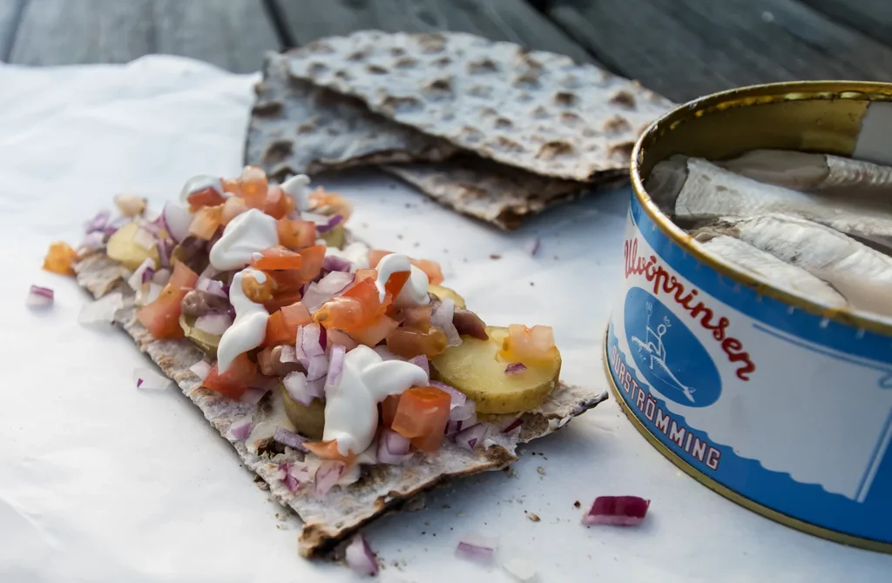
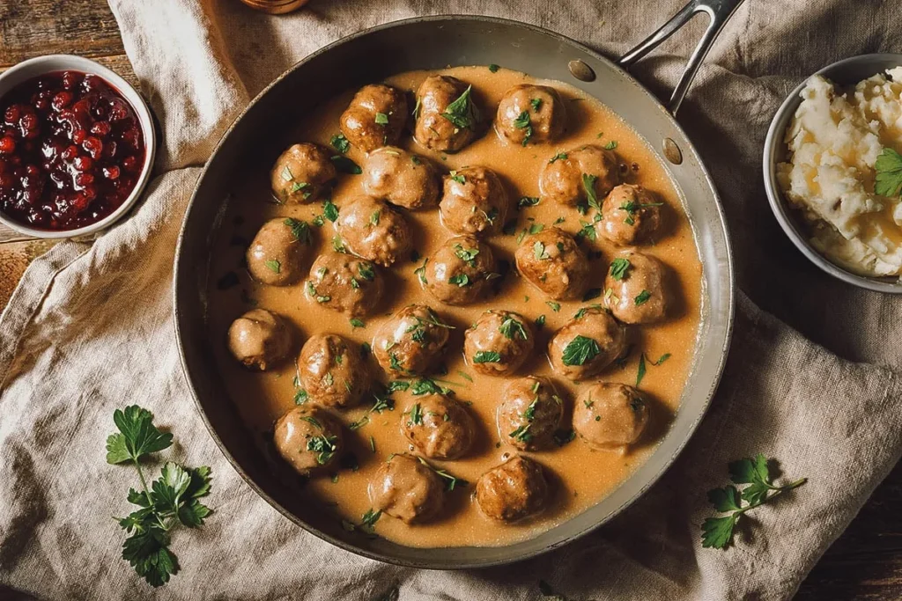
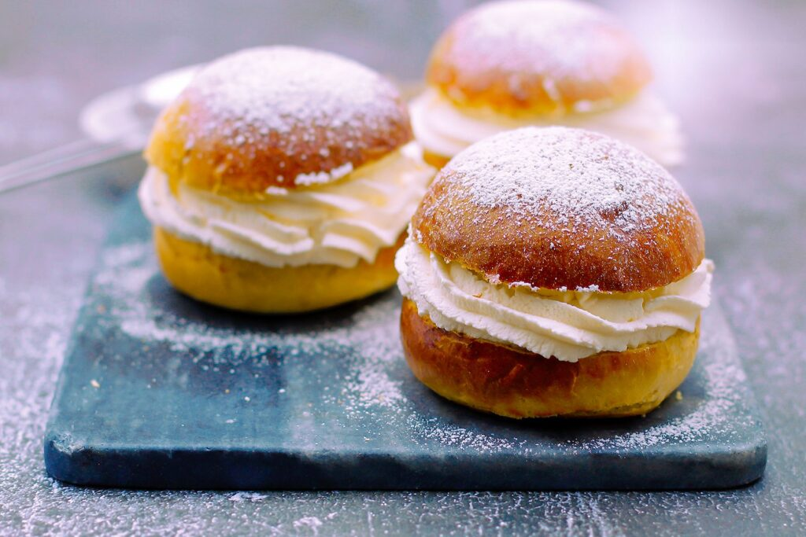
Swedish traditional dishes
SURSTROMMING
Pickled herring
SEMLA
Swedish cream bun
KOTTBULLAR
Swedish meatballs

Slide 3

Striving for comfort,
coziness and
inner balance

Slide 4
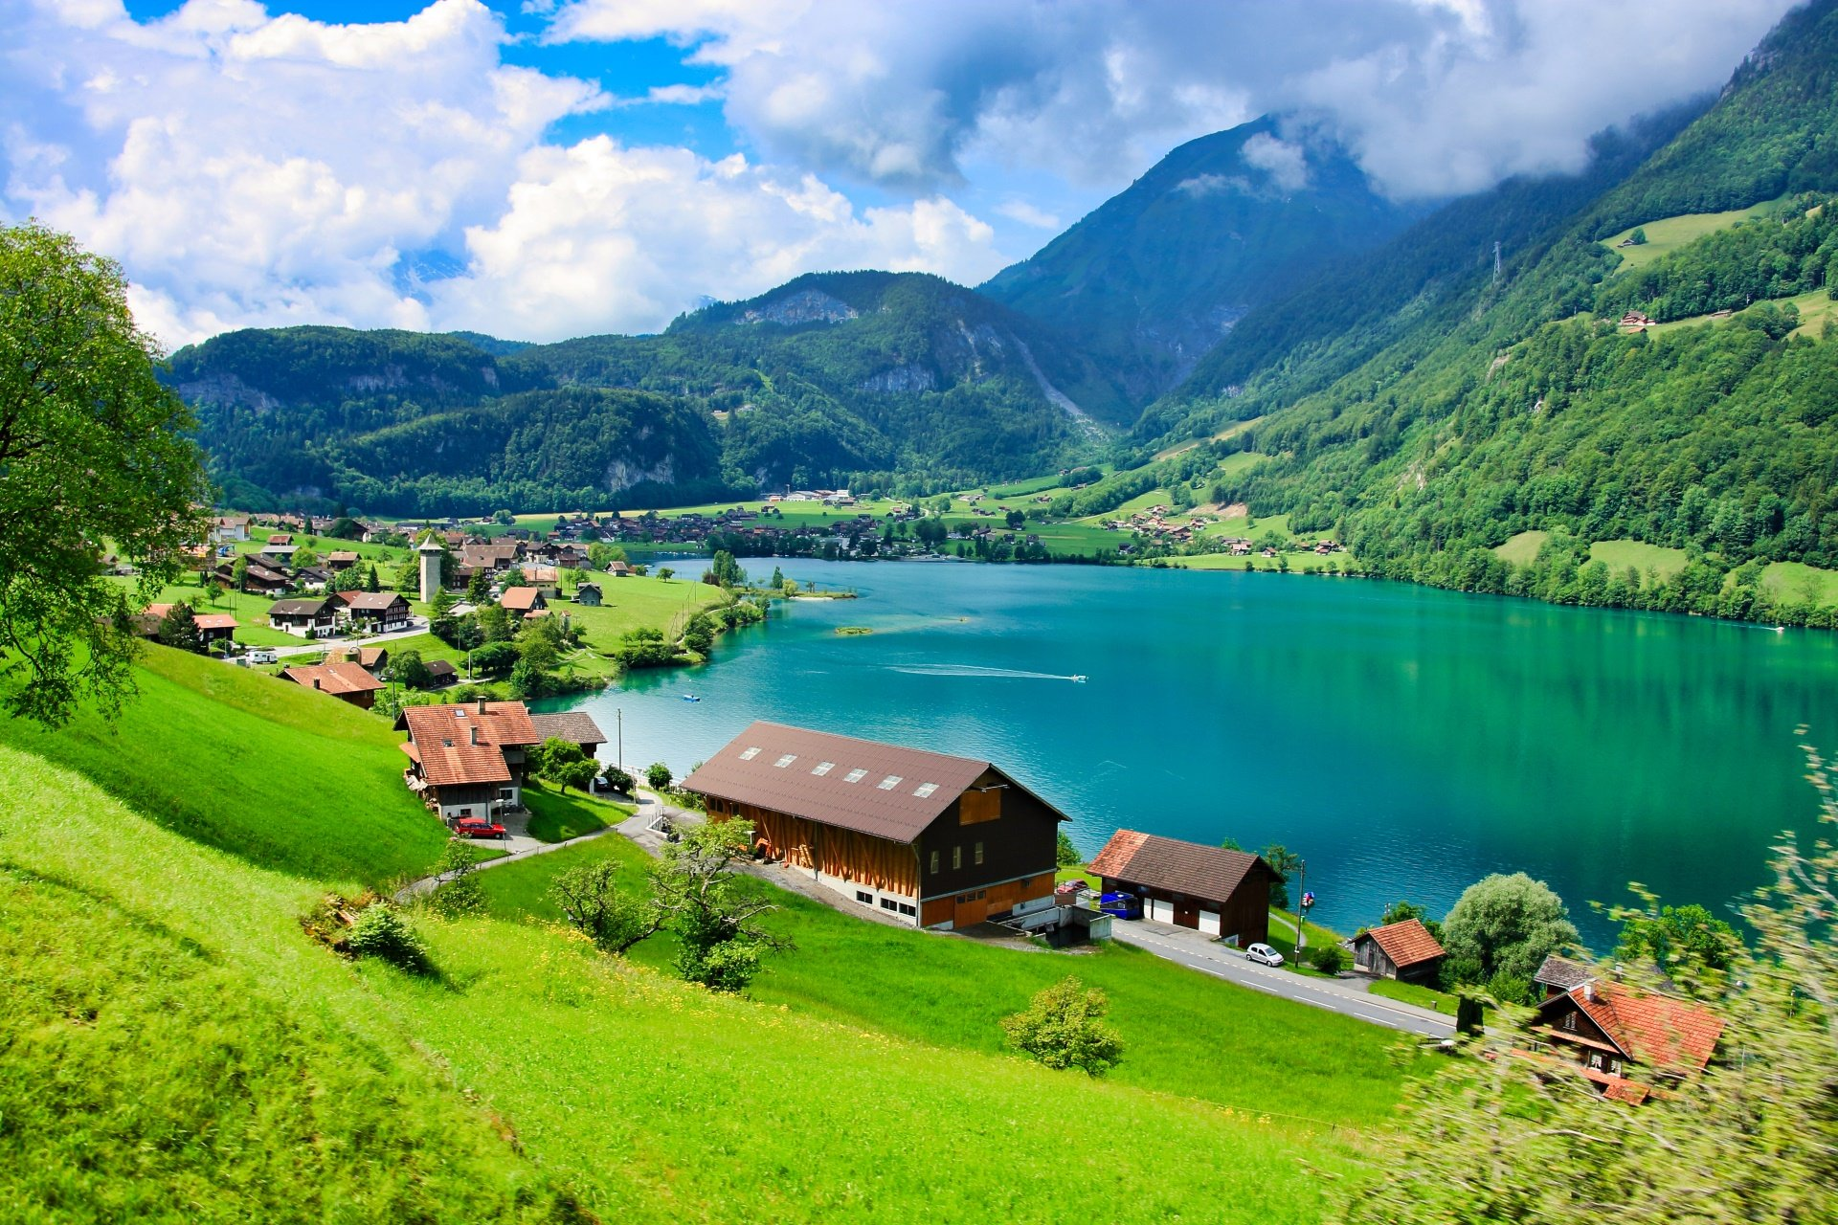
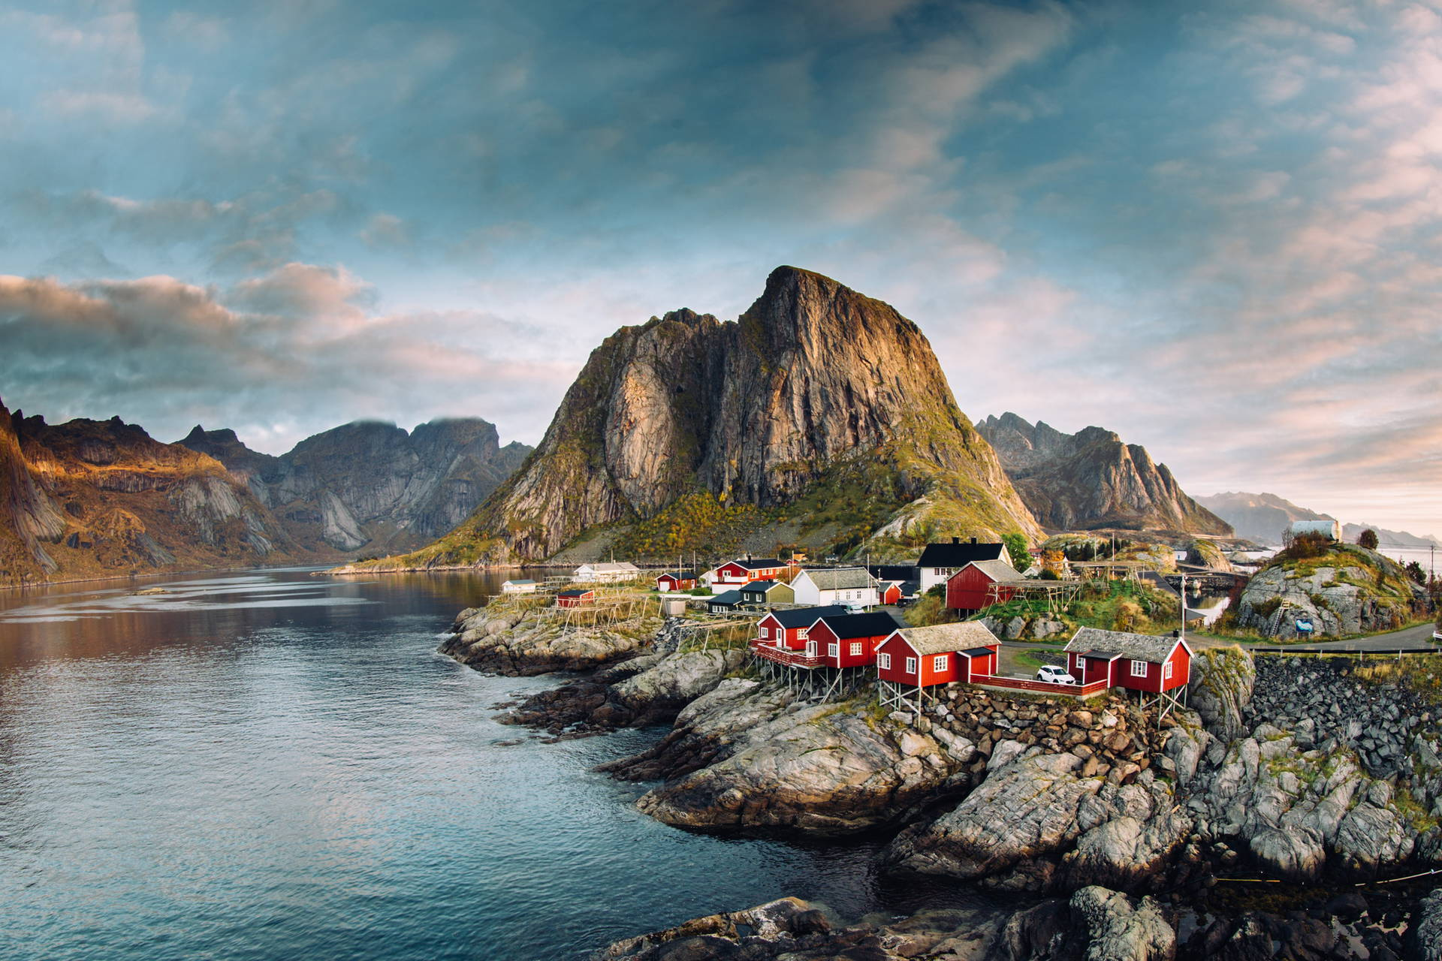
Nature
The most beautiful landscapes in Europe

Slide 5
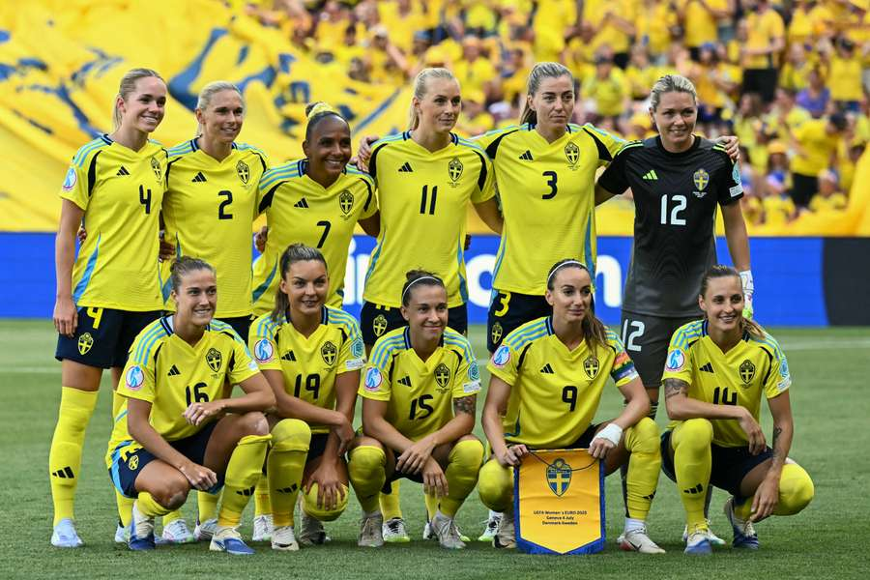
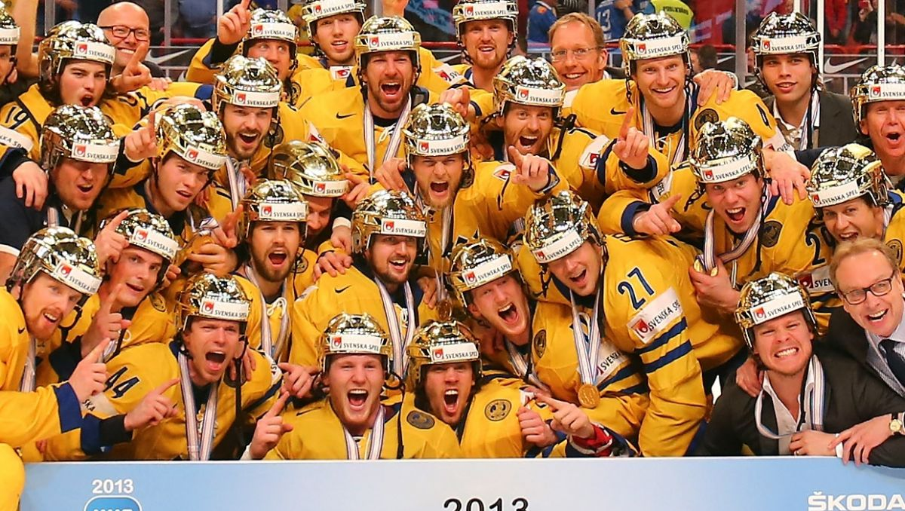
Sweden’s nationial sports

Slide 6
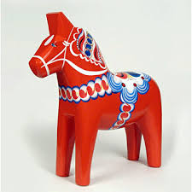
Thank you for your attention!

